Slide 1
What is IIM?
IIM App
iPad Client
Integration
IIM Services
Email
Interface
IIM Web
Account
Payment
Administration
An information delivery and management solution.

Slide 2
Which Information?
Storage
Box.com
Dropbox
Open Services
Twiter
facebook
Custom
SharePoint
CMS
Email
RSS
External connection
Public Storage
New media
Cloud

Slide 3
Which Information?
Local integration
Local Storage
Email
Other Apps
Interaction with other Apps
Plug-in supported
Use iPad local storage and resources

Slide 4
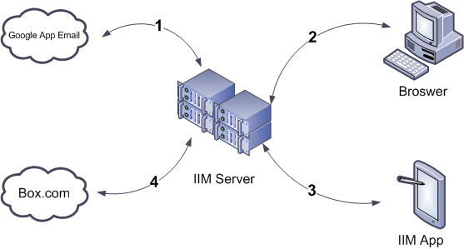
How it works?
IIM Server is a Linux based env
Google App Engine integration
Box.com is the default public Storage

Slide 5
Features
Download documents from public storage
View RSS content from IIM App
Parser Email from client and store the attachment
Integration with Open Services
Custom tag
Notes
Integration with Other Apps
Custom Enterprise storage

Slide 6
What’s the Core Competence
Integration with various of external channel
Understand of finance software
Experience of Enterprise level architecture

Slide 7
Current Status
IIM App almost finished
Only support box.com
Email parsing module is on going
API and portal is on going

Slide 8
Consumer Version
Business Version
Enterprise Version
Free download from App Store
No backend support by IIM Server
Use personal box.net account
No Email parsing function
Register from IIM Web
Email parsing support
Multiple account support
Box.net or other public storage support
Integration with other Apps
Setup private storage
Integration with Enterprise product
Custom function development
High security standards
Rollout strategy

Slide 9
What’s the further?
Consumer version is a general information management client for personal use
IIM Business version is a powerful tool for fiance/fund guys
More specific product in other industry
Real Estate Sales
Insurance Sales
…

Slide 10
Pricing Model
Let me demo it!
Launch IIM
Switch to Download View
Input box.com u/p
Drag the file to Local folder
Wait for download it
Open the PDF Pricing Model

Slide 11
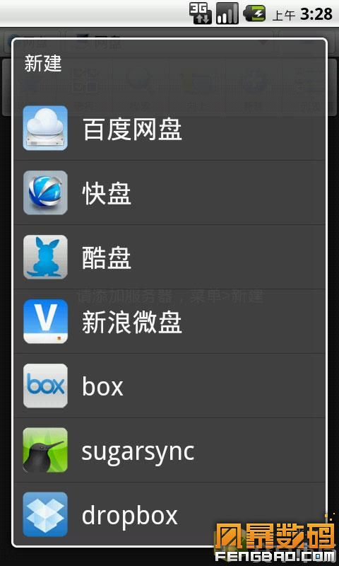
Problems
Similar product

